Slide 1
Macrophage

Slide 3
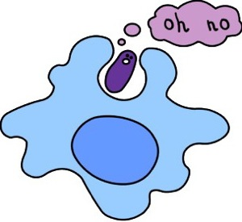

Slide 4
Innate Immune system
No memory
Fast

Slide 8
Go to spleen lymph node where T cells are

Slide 9
T cell
Already educated at birth; only recognize one thing

Slide 10
T cell
Already educated at birth; only recognize one thing

Slide 11
T cell
Already educated at birth; only recognize one thing

Slide 12
T cell
Already educated at birth; only recognize one thing

Slide 13
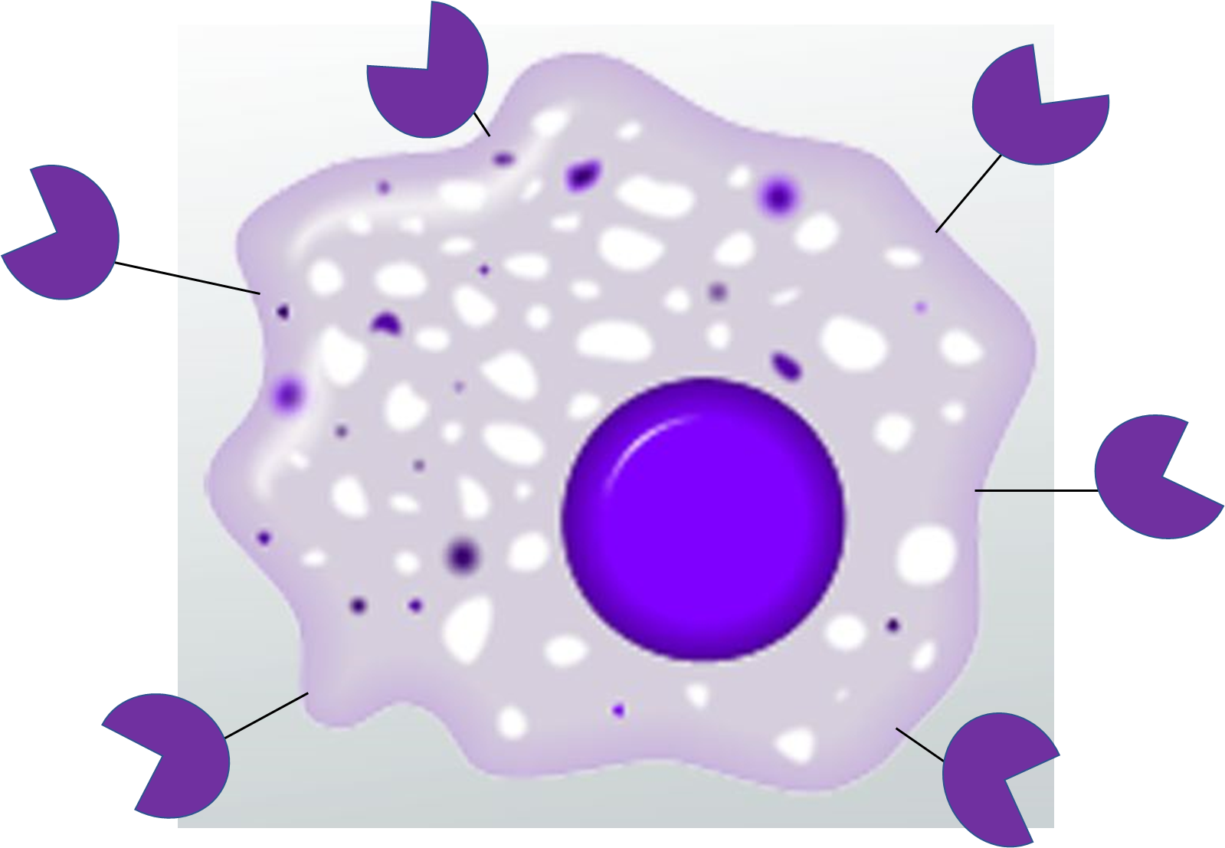
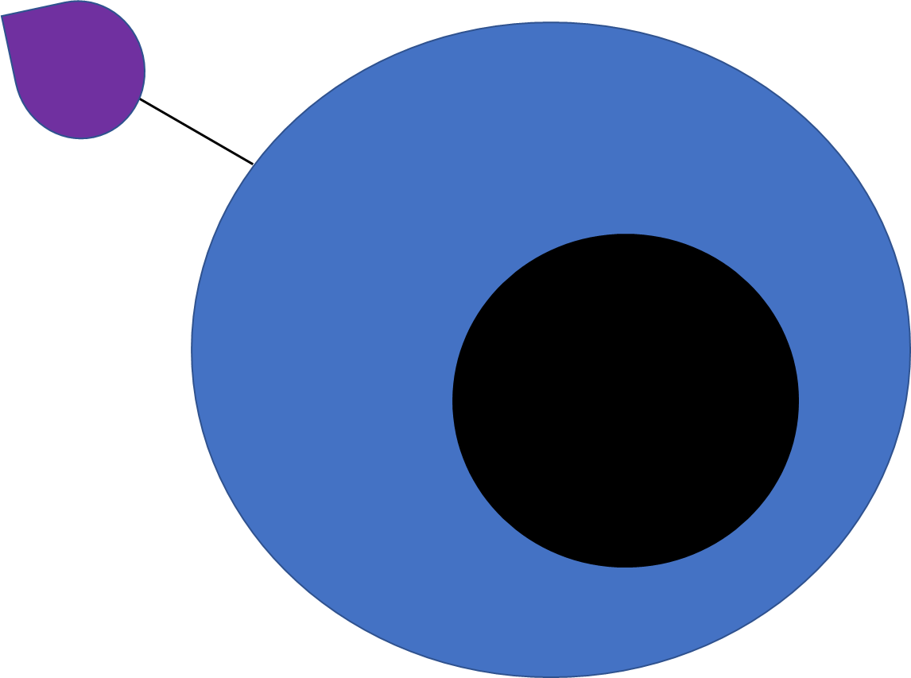

Slide 16
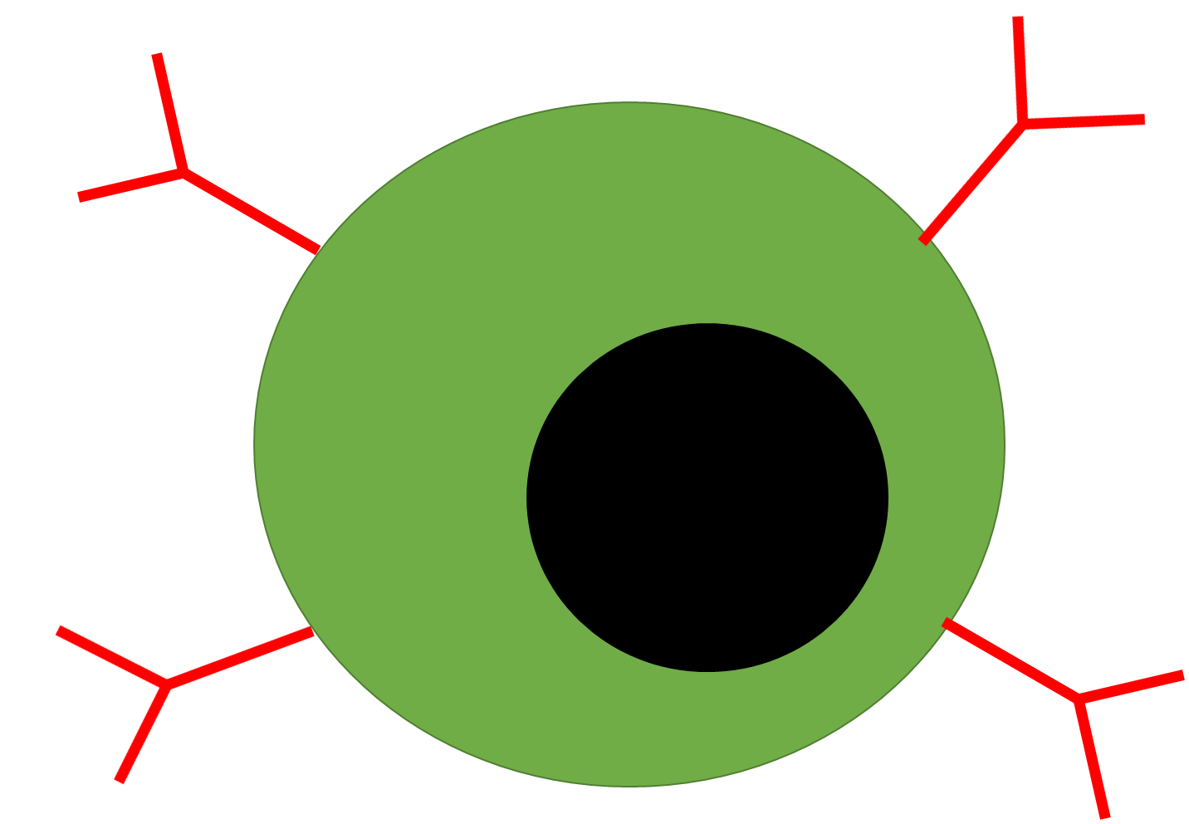

Slide 18
