Slide 1
Organismal card sorting activity
Small groups and whole-class discussion

Slide 2
Notes for instructor:
Print out enough card sets (small size) for groups of 3-4 students. Print out one large set of cards (large enough to be visible for the whole room).
Have groups spend ~10 minutes sorting the cards. Emphasize that there is NO right or wrong answer. If they don’t know what the organism is, they shouldn’t look it up – they need to sort it based on the attributes visible in the photo. Groups must document why they’ve chosen the categories they have (ex: lives on water vs. land, things I like to eat vs. not, things with eyes vs. not).
When most groups are nearly done, use the large cards on a whiteboard or a wall to generate categories that the whole class agrees upon. Choose one organism (I like to start with a weird one, like the kiwi bird), and choose one group to come up to the front of the class. Ask them what they grouped with it. Based on their answer, ask the rest of the class whether they agree, or whether they’d like to propose an alternative. Can use this method to emphasize many of the challenges of creating phylogenies, both historically and currently. Should also emphasize the idea of reaching a consensus as a class (and not the “truth”) to show how biology actually works. Depending on students’ prior knowledge, can interject new information to guide the discussion (or choose a student who will know the information) – for example, if many students agree that jellyfish and sharks are related, tell them that you’ve done some dissections on the jellyfish specimen, and found that they lack a brain.
This activity is most useful before starting a discussion of the actual current phylogeny of life – it allows students to explicitly confront their own assumptions about living things before memorizing how biologists categorize life. It also presents them with some of the real challenges of categorization, which allows them to appreciate the importance of what may otherwise seem like subtle differences.

Slide 3
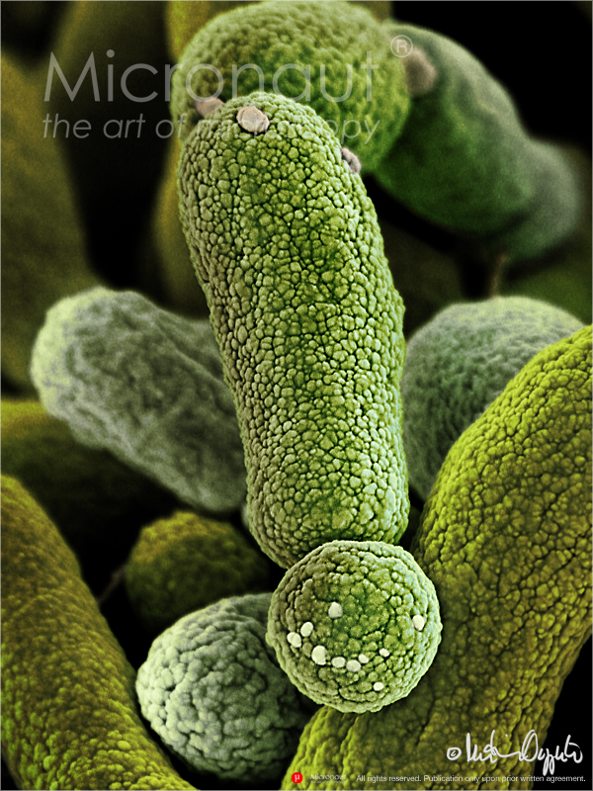
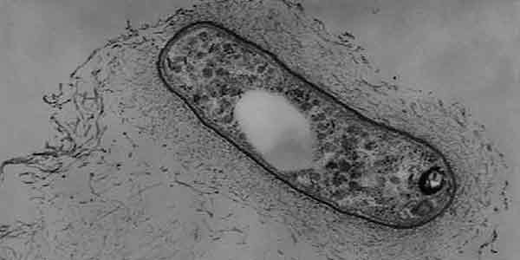
rhizobium
bacteria

Slide 4
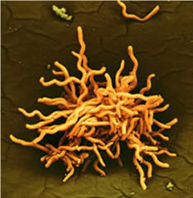
spirochetes

Slide 5
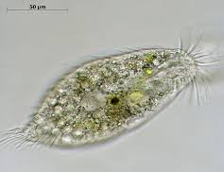
oxytricha

Slide 6
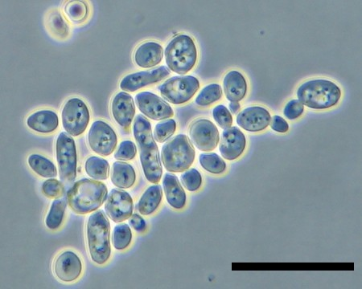
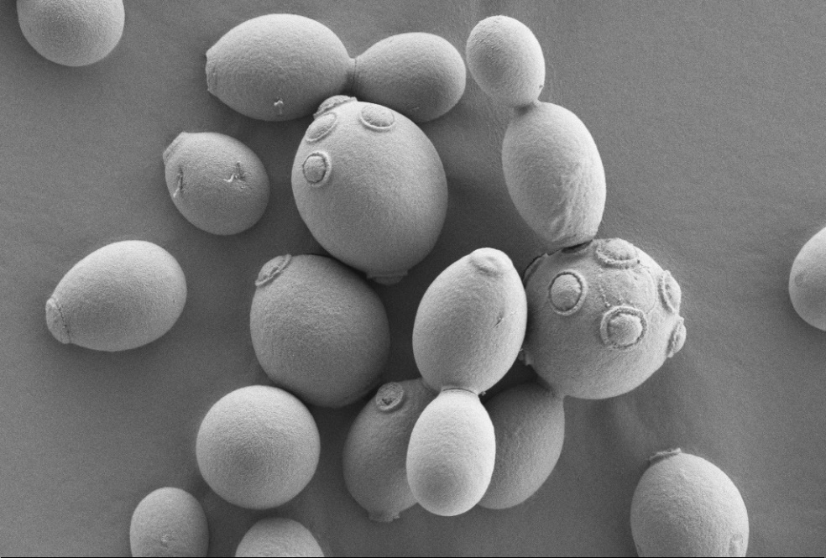
budding yeast

Slide 7
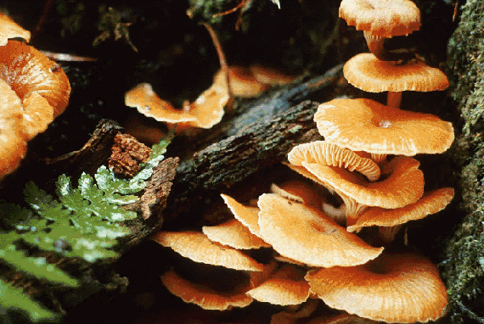
armillaria

Slide 8
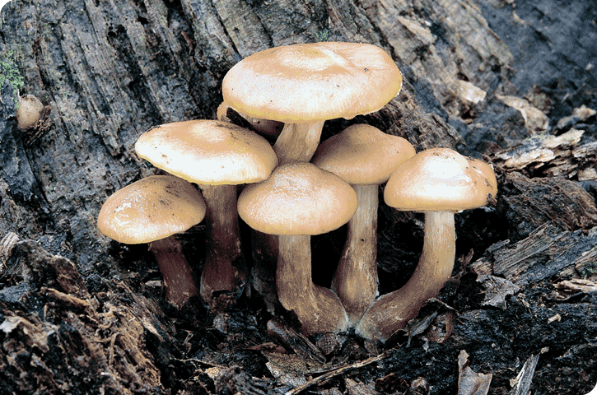
mushroom

Slide 9
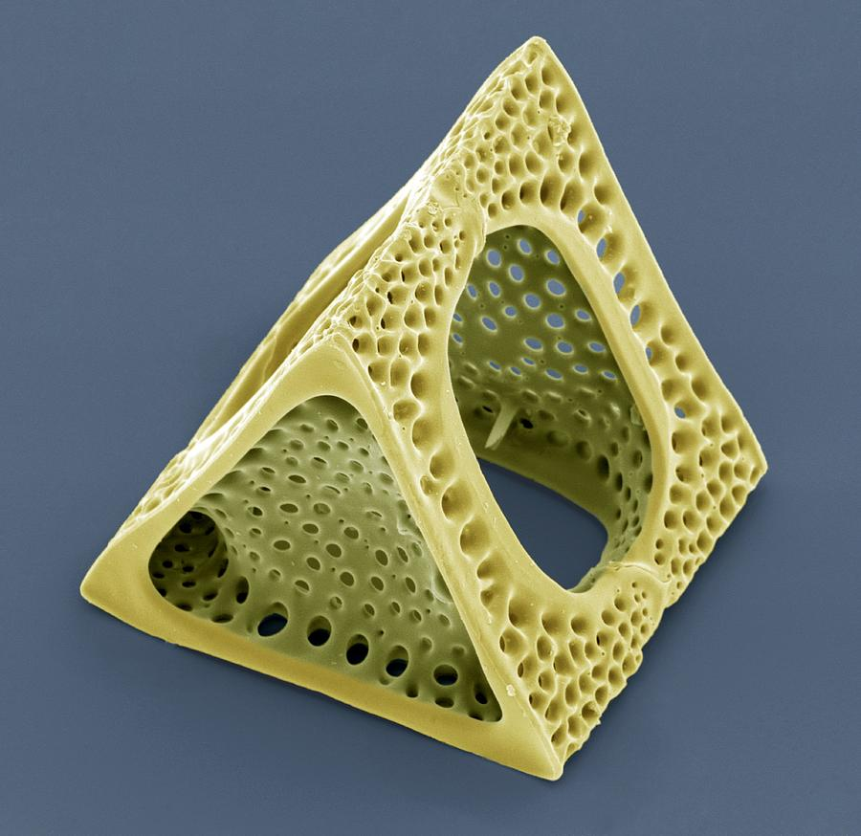
diatom

Slide 10
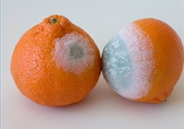
mold

Slide 11
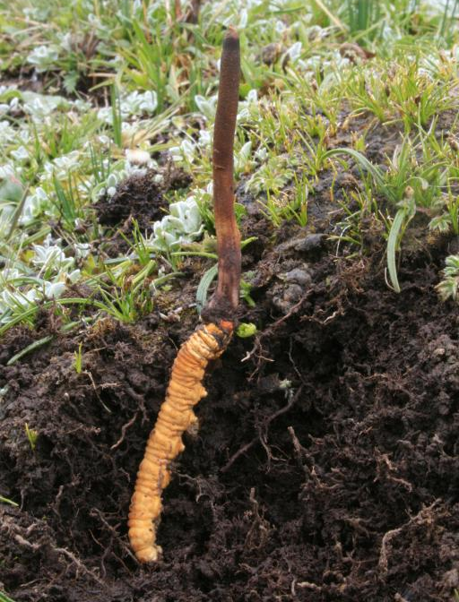
caterpillar fungus

Slide 12
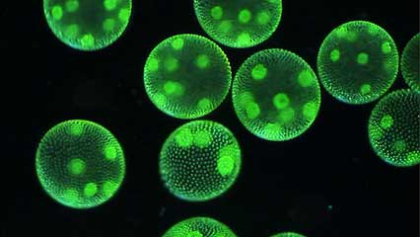
volvox

Slide 13
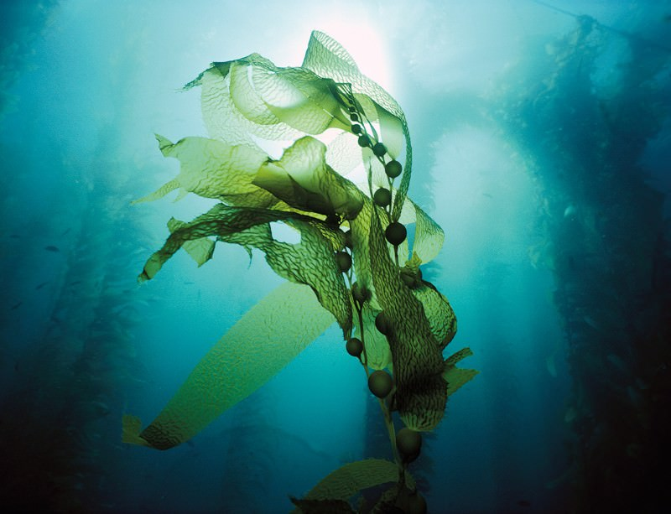
kelp

Slide 14
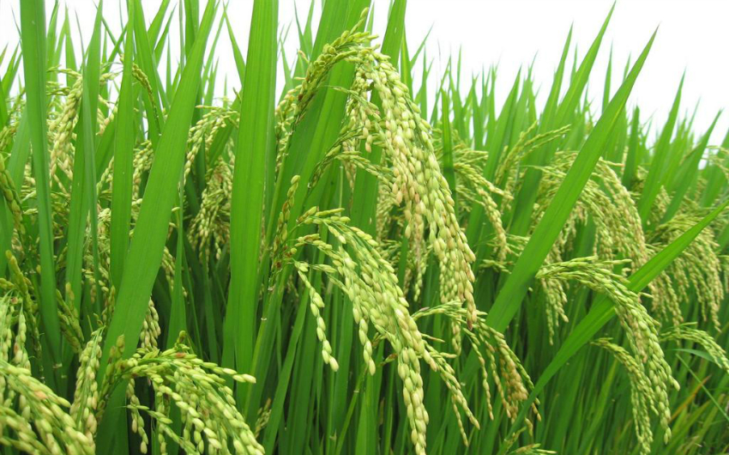
rice

Slide 15
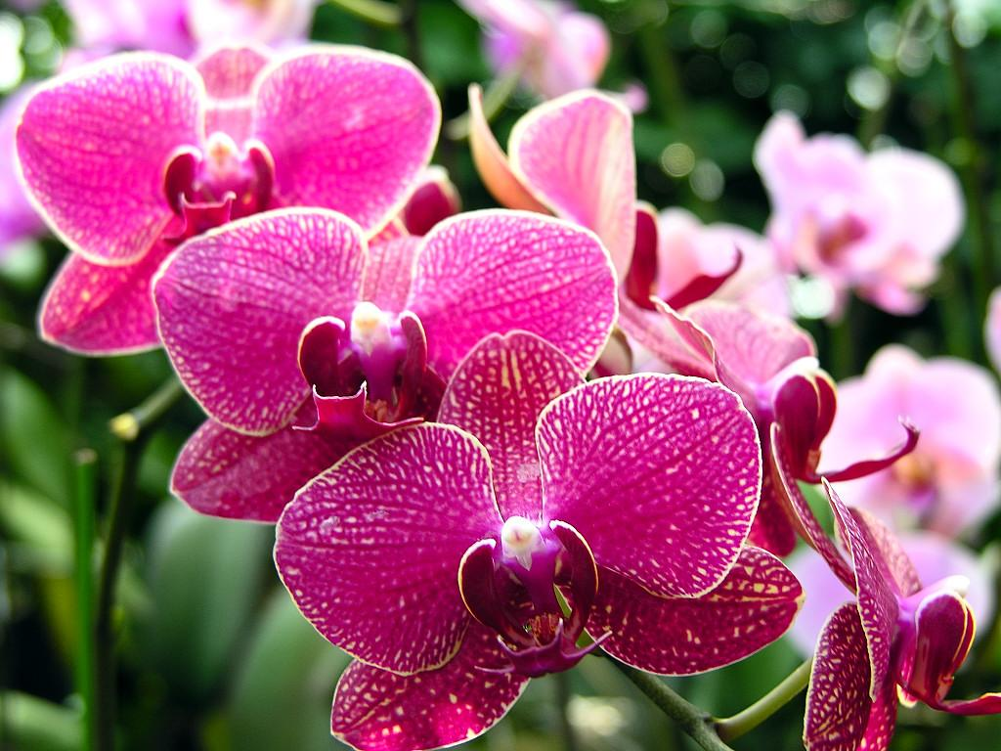
orchid

Slide 16
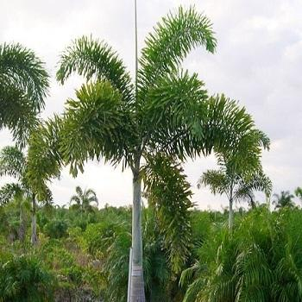
palm

Slide 17
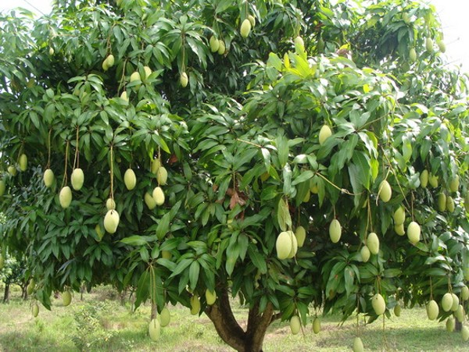
mango

Slide 18
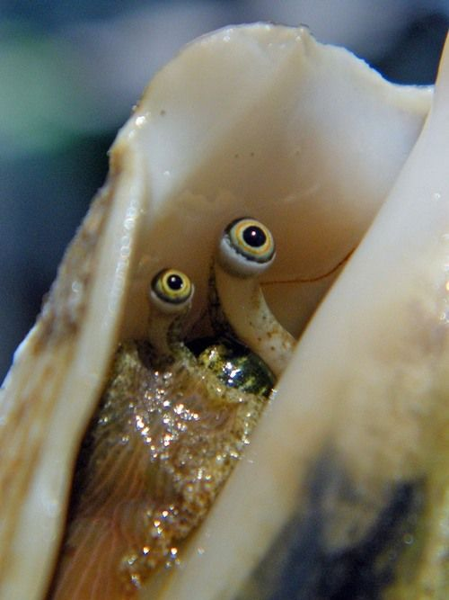
conch

Slide 19
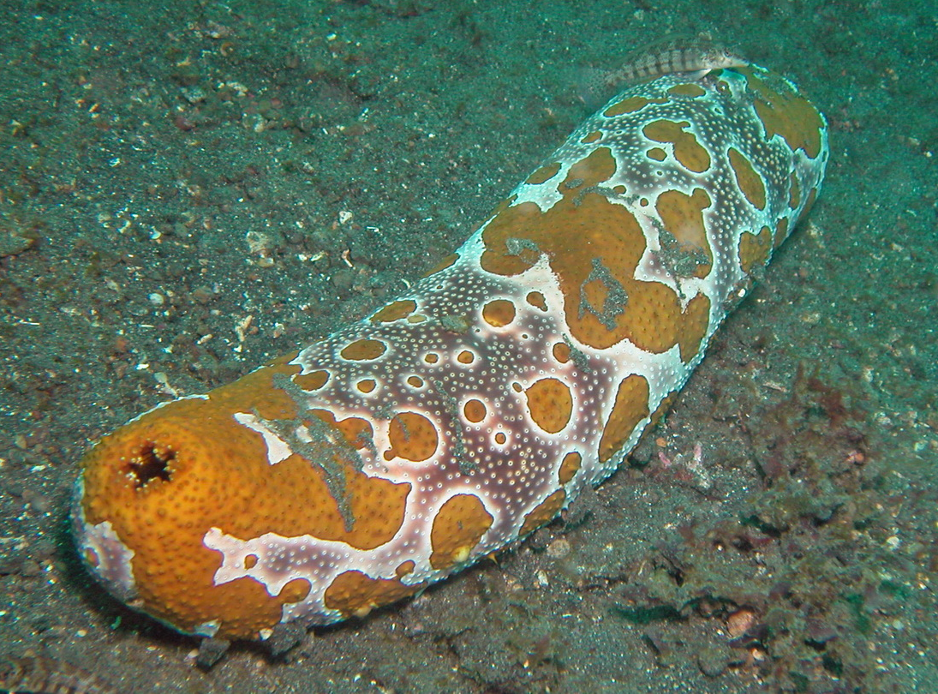
sea cucumber

Slide 20
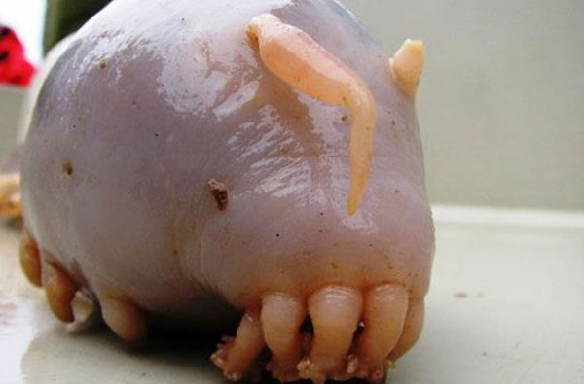
sea pig

Slide 21
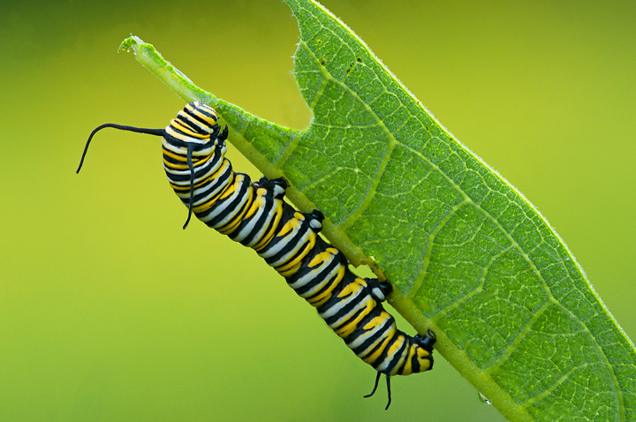
caterpillar

Slide 22
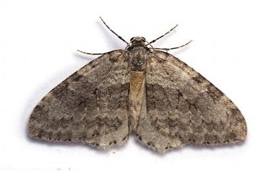
moth

Slide 23
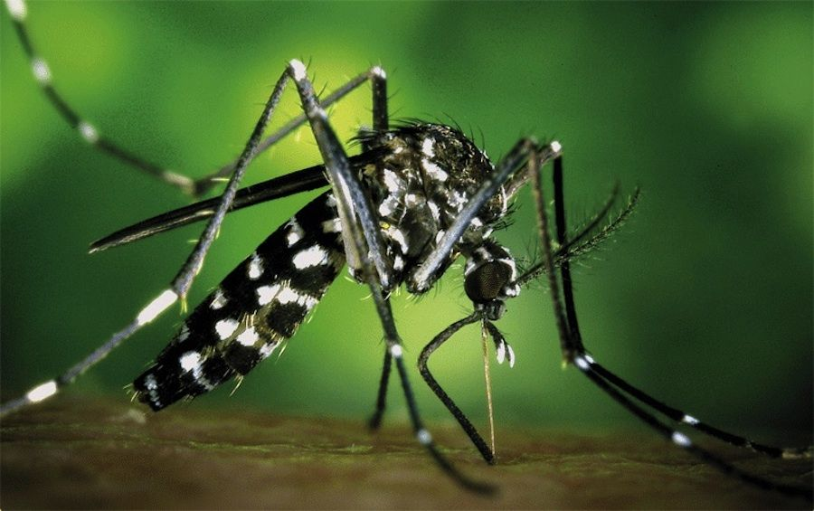
mosquito

Slide 24
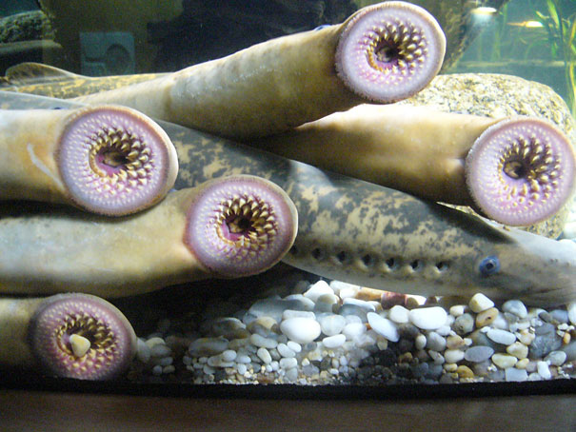
lamprey

Slide 25
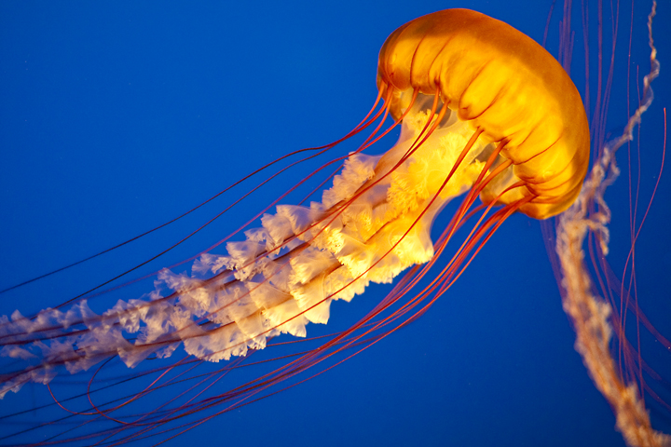
jellyfish

Slide 26
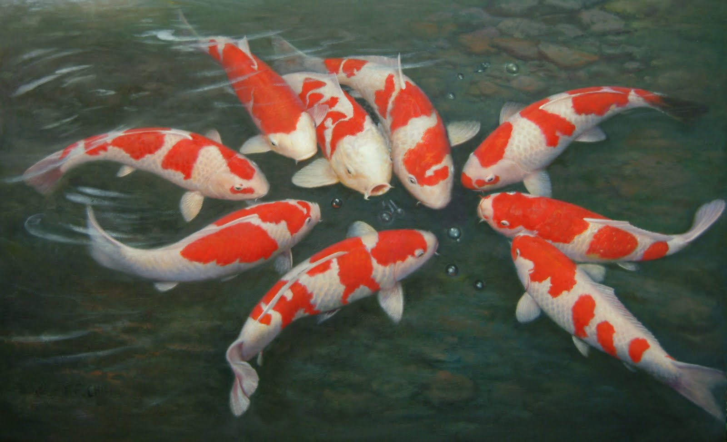
koi

Slide 27
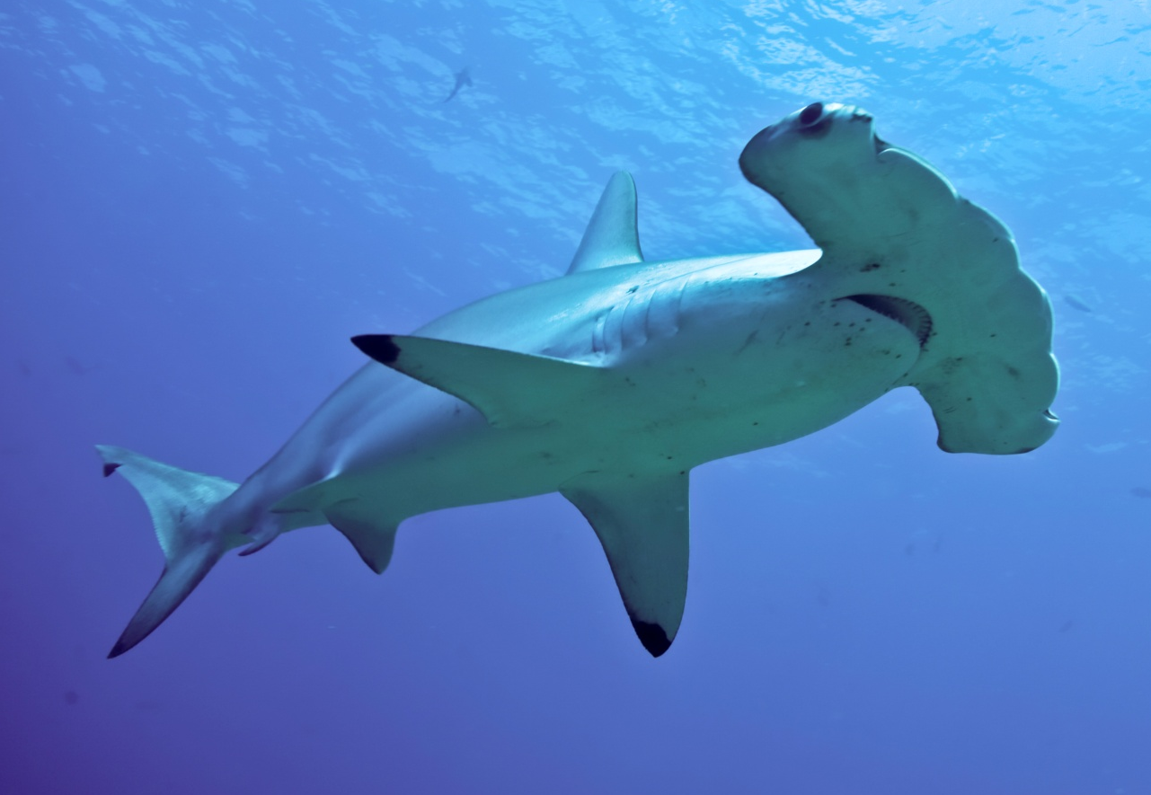
shark

Slide 28
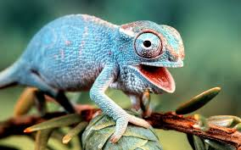
iguana

Slide 29
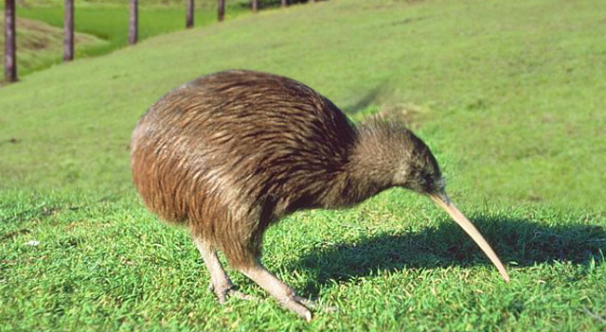
kiwi

Slide 30
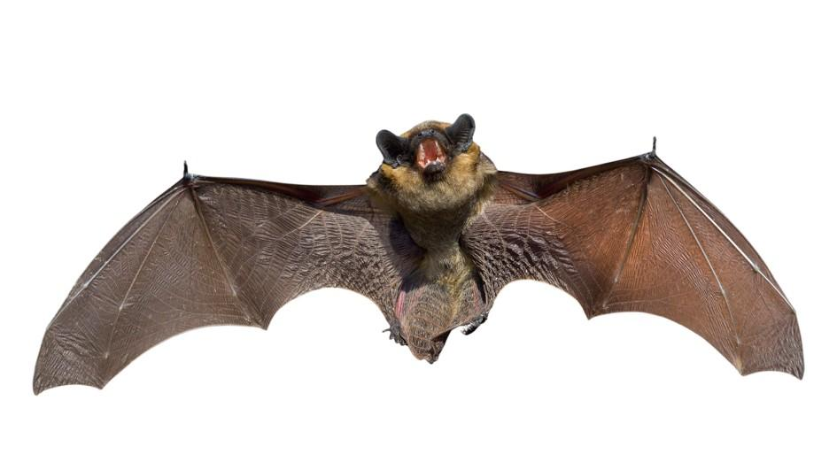
bat

Slide 31
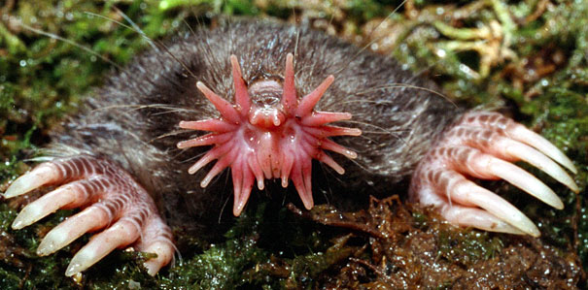
star-nosed mole

Slide 32
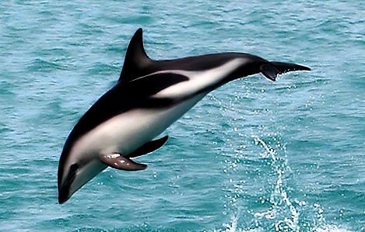
dolphin

